Slide 1
AIR POLLUTION MONITORING AND ALERT SYSTEM PAVAN
GUIDED BY,
PROF. S.KALPANA,
ASSISTANT PROFESSOR,
DEPARTMENT OF INFORMATION TECHNOLOGY
AGILAN S 15EUIT003
FAHEEN FATHIMA B N 15EUIT030
HARISH RAJ 15EUIT036
HINDU SREENI 15EUIT040
KARTHIK U 15EUIT048

Slide 2
LITERATURE SURVEY
“IOT-based Air Pollution Monitoring and Forecasting system”, Chen Xiaojun,Liu Xianpeng,Xu Peng, International Conference on Computer and Computational Sciences (ICCCS) 2015.
IDEAS USED:
IOT based system which detects the pollution level in a particular area and predicts the outcome using algorithms.
Disadvantages:
has no integrated environment showing the levels of pollutants (less user-friendly)

Slide 3
2. “Wireless sensor network based pollution monitoring system in metropolitan cities”,Shwetal Raipure, Deepak Mehetre. IEEE ICCSP2015 conference
IDEAS USED :
Sensor combination which monitors pollution and detects the presence or absence of it. It uses NFC devices to gather and transfer data.
“Disadvantage :
uses a bluetooth support devices to gather data from the sensors which is probably a short range device.

Slide 4
3.“Smart Vehicle Monitoring System for Air Pollution Detection using Wsn”, Suganya E, Vijayashaarathi S, IEEE ICCSP 2016 conference .
IDEAS USED :
Wireless Sensor Network(WSN) based system which detects the pollution level 300meters around the city using MANET(Mobile Ad Hoc Network) routing algorithm.
Disadvantage :
There are numerous restrictions on hardware and
are also various issues on the WSN software such as
routing protocol,media access control exposure and
power management.

Slide 5
WIKIPEDIA DATA
Air pollution in India is quite a serious issue with the major sources being fuelwood and biomass burning, fuel adulteration, vehicle emission and traffic congestion.
In autumn and winter months, large scale crop residue burning in agriculture fields – a low cost alternative to mechanical tilling – is a major source of smoke, smog and particulate pollution. India has a low per capita emissions of greenhouse gases but the country as a whole is the third largest after China and the United States.
A 2013 study on non-smokers has found that Indians have 30% lower lung function compared to Europeans.

Slide 6
ARTICLES
THE INDIAN EXPRESS
updated 24th January,2018
India fourth worst country in curbing environment pollution.
India ranked 177 out of 180 countries in the Environmental Performance Index’s latest rankings.
With a score of 30.57, India fares better than only three countries-Democratic republic of Congo, Bangladesh and Burundi- in curbing pollution

Slide 7
THE HINDU
Updated 12th January 2017
A greenpeace report shows 90% of cities studied had pollution levels overprescribed standards
According to an analysis of 2015 data for 168 cities by Greanpeace India, 154 were found to have an average particular matter level higher than national standard.
Delhi was found to be the most polluted city, with the annual average of PM 10 being 268 micrograms per cubic meter, or over four times the 60 micrograms/cubic metre limit prescribed in the National Ambient Air Quality Standards of the Central Pollution Control Board

Slide 8
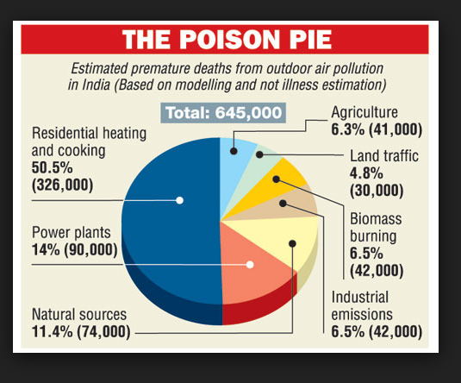
IDEAS Gathered
Outdoor pollution has risen 8% in five years with fast-growing cities in the developing world worst affected, WHO data shows
Government-operated pollution monitors are often expensive and therefore are few in number.
The Government has installed a single pollution monitor in most polluted cities for a million people which is awfully inadequate.
The idea of a low cost and a simple device is always welcome in the market for installation in many places around the cities.

Slide 9
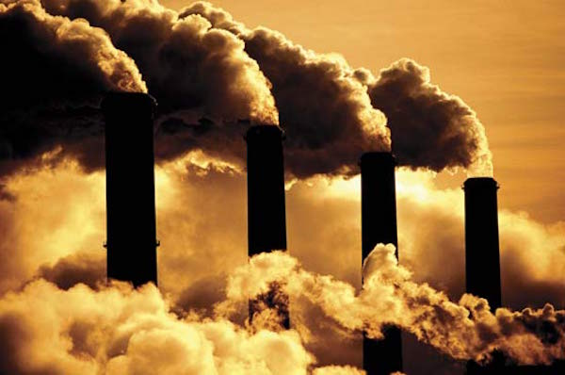
EXISTING SYSTEM
IDEAS USED
Sensor based pollution detection system in metropolitan cities
IOT based monitoring system to monitor the area with pollution.

Slide 10
DRAWBACKS OF EXISTING SYSTEM
Measures the amount of toxicity but does not provide the source of pollutants causing the pollution
Surveillance of the area for air pollution but costly mechanism comparatively
It does not provide proper means for public to access the data and also lacks interface with the sensors and front end

Slide 11
Problem Statement
Increase in pollution in recent years by manifold
Unawareness of the growing impact on pollution by the people
Increase in several pollutants level in air
Lack of monitoring system in localities where pollution is increasing
Lack of low cost integrated system to alert people of the increasing toxic level in air.

Slide 12
PROPOSED SYSTEM
Introducing PAVAN which is the combination of software and hardware that is used for sensing, processing and alerting the environment about the toxicity levels present in the air
An application to make normal people aware about the total pollutants and its sources.
Detecting the toxicity level of each pollutants individually in PPM.
Alerting the environmentalists about the rising dangers of air pollution using GSM/GPRS module.

Slide 13
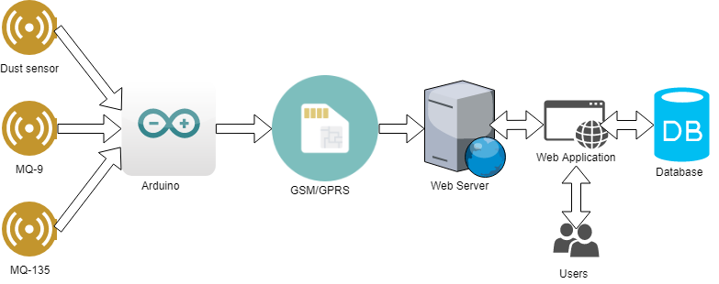
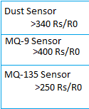
SYSTEM ARCHITECTURE

Slide 14
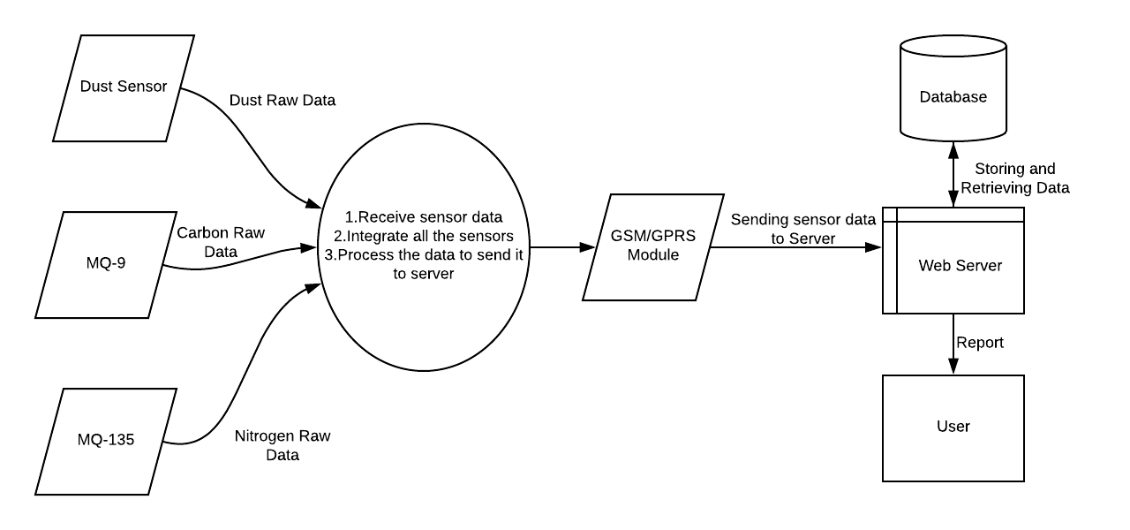
Context diagram

Slide 15
FEASIBLITY STUDY
Economic feasibility
Technical feasibility
Operational feasibility
Legal feasibility

Slide 16
ECONOMIC FEASIBILITY
Economic feasibility is the most frequently used method for evaluating the effectiveness of a new system.
The proposed model includes the initial investment of Arduino UNO, sensors and other components.
Minimum requirements of the software specifications is less due to the open source tools.
Software/hardware cost, Total estimated cost of the project, Financing of the project, Cost-benefit analysis , Projected cash flow and profitability are all reasonable .
Therefore the proposed system is economically feasible.

Slide 17
TECHNICAL FEASIBILITY
The Software/IDE’s , Programming languages , Automatic software testing tools and Platforms requirements are all available, therefore the project meets all the technical needs.
The team is also knowledgeable and expertised with the tools available .
The proposed Air pollution monitoring and alert system is therefore technically feasible by meeting the required resources and it satisfies the required technologies.

Slide 18
OPERATIONAL FEASIBILITY
Operational feasibility is a measure of how well a proposed system solves the problems.
The proposed system takes advantage of the opportunities identified during the project scope definition and it satisfies the requirements identified in the requirement analysis phase of system development.
Once the toxicity level of the pollutants cross the limit it can be immediately alerted thereby avoiding the hazardous threats.
The installation cost of the system is also low as only sensors are used.
Therefore, the proposed Air pollution monitoring and alert system is operationally feasible.

Slide 19
LEGAL FEASIBILITY
Legal Feasibility determines whether the proposed system conflicts with legal requirements
In the proposed system, the legal issue is to obtain the permission for installing the project in particular area from the government authorities.
Based on the range of the sensor capacity of sensing the pollutants the number of installation of the sensors in a particular area or a city is estimated.
Once the project is approved, the implementation can be done. Thus our project is legally feasible.

Slide 20
REQUIREMENTS
HARDWARE REQUIREMENTS
Arduino uno
MQ-9
MQ-135
DUST SENSOR
GSM Module
SOFTWARE REQUIREMENTS
Arduino IDE
Python IDE
Netbeans IDE
Apache Tomcat
XAMPP

Slide 21
Modules list
Sensing the environment (sensors)
Processing the sensor data(Arduino)
Correlating the source of pollutants(GSM/GPRS module)
Storing the pollutant data(web server)

Slide 22
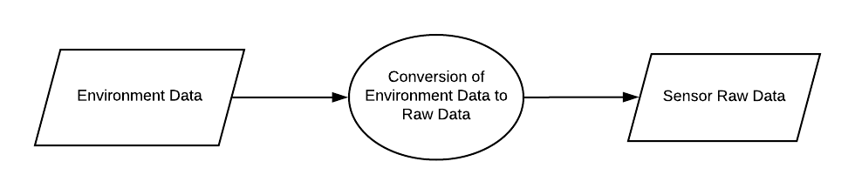
SENSORS Sensing the environment
MODULE 1

Slide 23

MODULE 2
ARDUINO Processing the sensor data

Slide 24
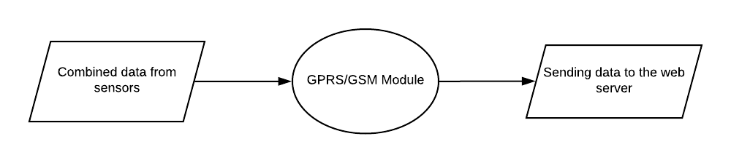
MODULE 3
GSM MODULE Correlating the source pollutants

Slide 25
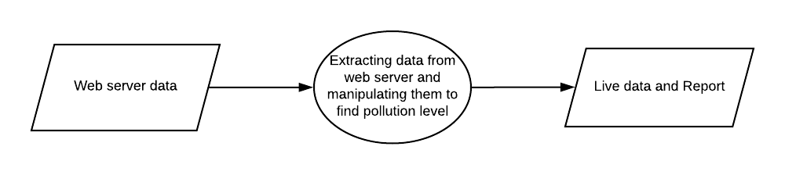
MODULE 4
WEB SERVER
Storing the pollutant data

Slide 26

Implementation
Serial Monitor:

Slide 27
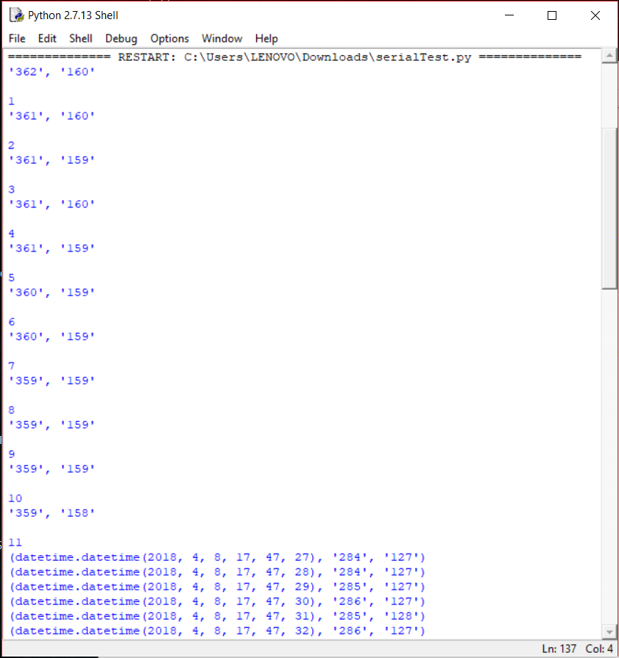
Python shell:

Slide 28
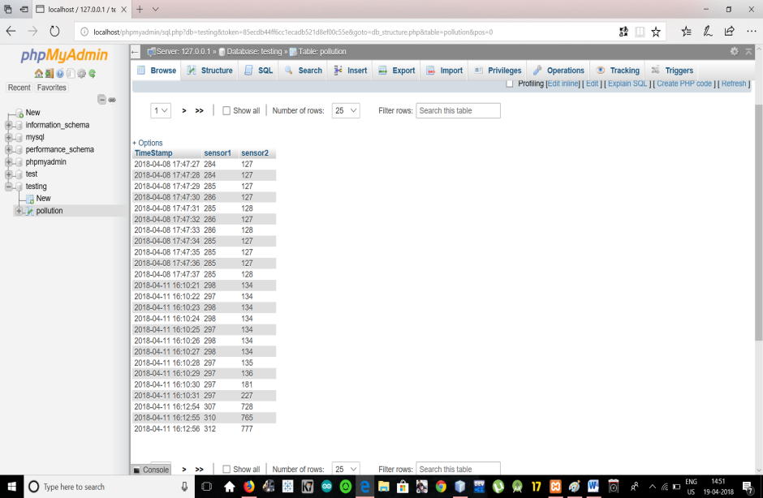
Database:

Slide 29
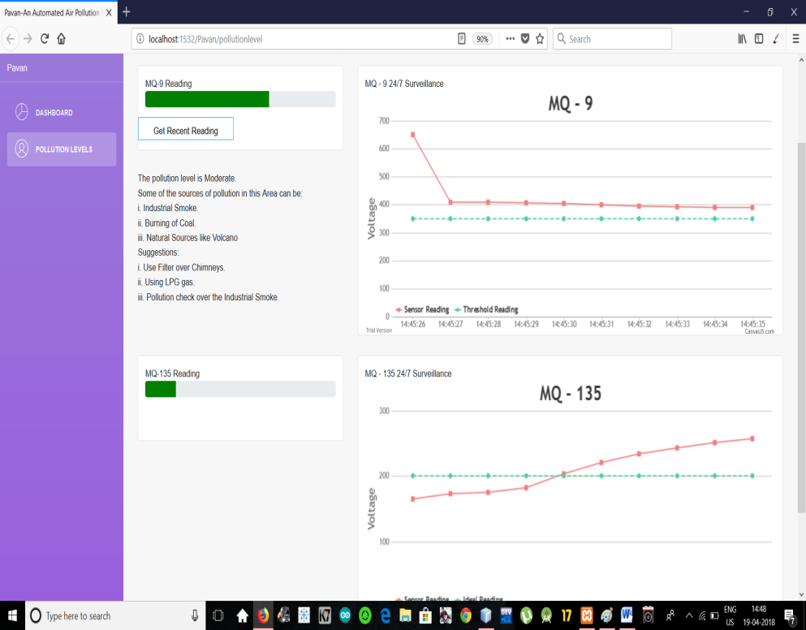
Front End:

Slide 30
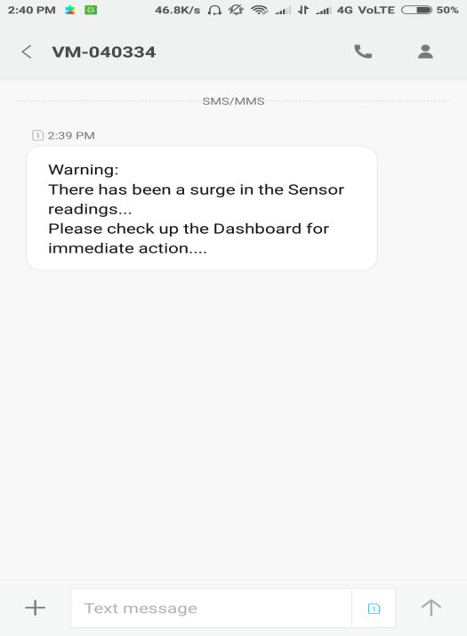
Warning Message:

Slide 31
conclusion
Thus PAVAN provides user friendly approach towards the environmental education. It can clearly detect and alert the sudden rise in toxic level of air with proper measures and guidelines. Thus PAVAN proves to be an intelligent approach towards the protection and prevention of air pollution hazards met in the future.

Slide 32
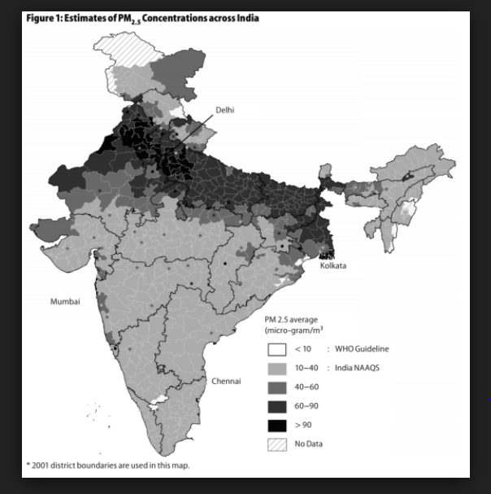
Social relevance
Pollution prevails to be a life-threatening problem that the whole world faces and hence it becomes a priority where every one has to be aware of the growing danger in the locality. Thus, the scope of PAVAN lies over all parts of the world.
PAVAN becomes an integrated system where the measure of pollutant levels can be identified uniquely for each pollutant and can be improved over the effects of toxicity it causes. Moreover, it can provide a statistical report of the toxicity in air and the vulnerability of the locality to pollution.

Slide 33
Future work
Applying machine learning algorithms to the applied statistics to estimate and foresee the toxic level in air
Developing a mobile application with the web page to provide instant access to the pollution data level.
After several years of implementation when the data acquired is manifold, data analysis can be used to handle the mass data.

Slide 34
REFERENCES
[1] “Wireless sensor network based pollution monitoring system in metropolitan cities”,Shwetal Raipure, Deepak Mehetre. IEEE ICCSP2015 conference
[2] “IOT-based Air Pollution Monitoring and Forecasting system”, Chen Xiaojun,Liu Xianpeng,Xu Peng, International Conference on Computer and Computational Sciences (ICCCS) 2015
[3] https://circuitdigest.com/microcontroller-projects/iot-air- pollution-monitoring-using-arduino
[4] http://nevonprojects.com/iot-air-sound-pollution-monitoring- system/
[5] https://www.aeroqual.com/outdoor-air-quality
[6] https://plot.ly/arduino/air-quality-tutorial/
[7] http://www.instructables.com/id/Air-Pollution-Detector/
[8] https://www.google.co.in/amp/indianexpress.com/article/
[9] https://www.google.co.in/amp/thehindu.com/article/

Slide 35
THANK YOU!

